Slide 1

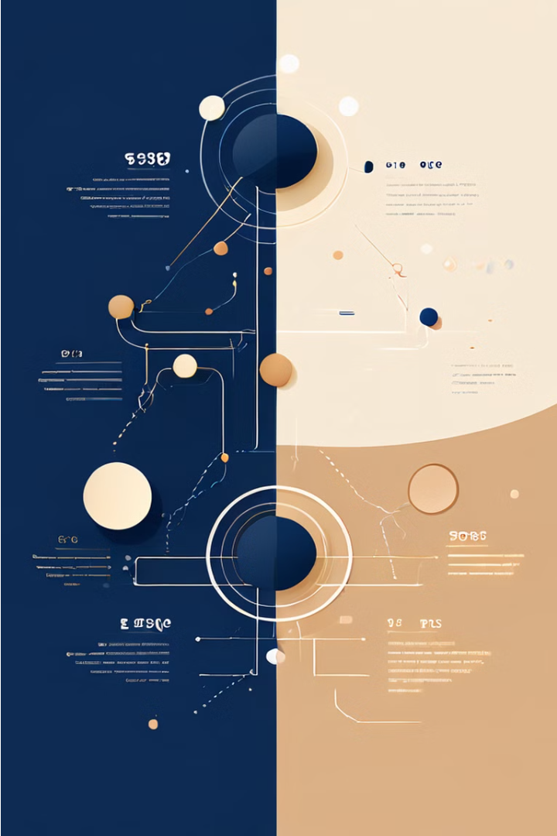
Introduction to Web Eras
The internet has evolved through several distinct eras, each marked by advancements in technology and user experience. This presentation will explore the key characteristics and developments of Web 1.0, Web 2.0, and Web 3.0, providing insights into the past, present, and future of the internet.

Slide 2
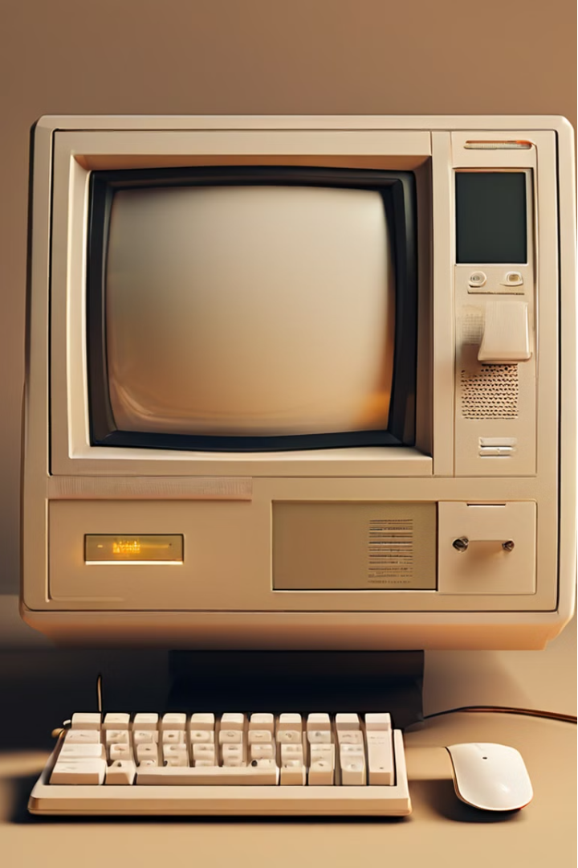
Web 1.0: The Static Web
Web 1.0 was the initial phase of the internet, characterized by static, information-based websites. Users could only passively consume content, with little to no interaction or user-generated contributions. This era laid the foundation for the world wide web, but lacked the dynamic and collaborative nature of later web developments.
Characteristics of Web 1.0
Static Content
One-way Communication
Websites were primarily focused on presenting information, with little to no interactive features.
Users could only consume content, with no ability to actively engage or contribute.
Limited Interactivity
HTML-based
Websites lacked dynamic elements, such as forms, shopping carts, or user profiles.
Web 1.0 technologies were primarily based on HTML, with limited use of client-side scripting.

Slide 3
Web 2.0: The Interactive Web:
Web 2.0 marked a significant shift in the internet's evolution, emphasizing user-generated content, social media, and interactive web applications. This era saw the rise of platforms that enabled users to actively participate, share information, and collaborate online.
Characteristics of Web 2.0
User-Generated Content
Social Interaction
Dynamic Applications
Web 2.0 fostered online communities, allowing users to connect, share, and engage with each other.
Web applications became more interactive, with features like real-time updates, user profiles, and web-based tools.
Platforms like blogs, wikis, and social media enabled users to create and share their own content.

Slide 4




Web 3.0: The Semantic Web
Web 3.0, also known as the Semantic Web, focuses on the integration of data and the use of intelligent, machine-readable information. This era aims to make the web more organized, interconnected, and capable of understanding the meaning and context of data.
Characteristics of Web 3.0
Data-Driven
Intelligent Agents
Interconnected Data
Decentralization
Web 3.0 relies on structured, machine-readable data to improve search, personalization, and decision-making.
Autonomous software agents can understand and process information, providing personalized and contextual experiences.
Emerging technologies like blockchain and decentralized applications are shaping the future of the web.
Web 3.0 leverages linked data to create a more cohesive and semantically-connected web.

Slide 5




The Future of the Internet
Web 4.0
The next generation of the internet, known as Web 4.0, may bring further advancements in artificial intelligence, virtual/augmented reality, and the Internet of Things.
Decentralization
Blockchain and decentralized technologies are expected to play a significant role in the

Slide 6
The Future of the Internet
Web 4.0
The next generation of the internet, known as Web 4.0, may bring further advancements in artificial intelligence, virtual/augmented reality, and the Internet of Things.
Decentralization
Blockchain and decentralized technologies are expected to play a significant role in the

Slide 7
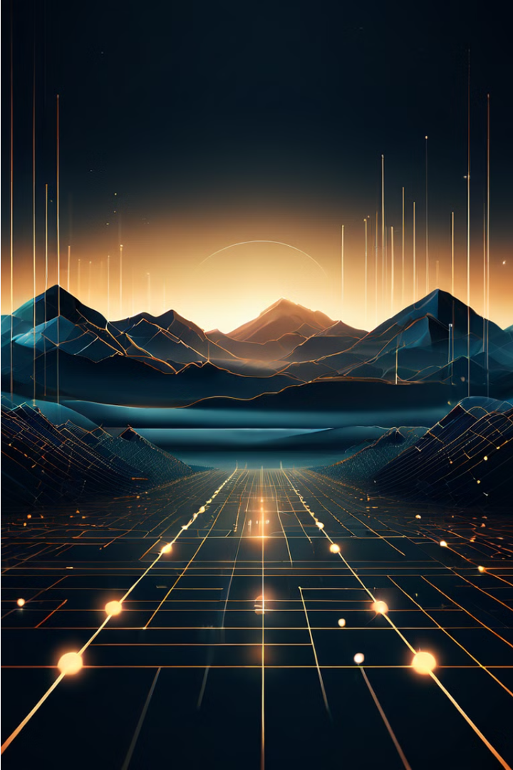
Introduction to Blockchain and NFTs
Blockchain and non-fungible tokens (NFTs) are revolutionizing industries worldwide. Blockchain is a secure, decentralized digital ledger that records transactions. NFTs are unique digital assets stored on a blockchain, enabling new models for digital ownership and monetization.

Slide 8




What is Blockchain?
Decentralized
Secure
Transparent
Automated
Blockchain is a decentralized network, meaning it is not controlled by a single entity.
Blockchain uses cryptography to ensure the integrity and security of data.
All transactions on a blockchain are recorded and visible to network participants.
Blockchain leverages smart contracts to automate and streamline processes.
Understanding Non-Fungible Tokens (NFTs)
Unique Digital Assets
Digital Ownership
NFTs are one-of-a-kind digital items, such as art, collectibles, or virtual real estate, that are stored on a blockchain.
Scarcity and Value
NFTs allow for the verification and ownership of digital items, creating new opportunities for creators and collectors.
The scarcity and uniqueness of NFTs can drive their value, much like physical collectibles.

Slide 9
Applications of Blockchain and NFTs
1
Art and Collectibles
2
Gaming and Virtual Worlds
NFTs enable digital artists to sell unique, verifiable works and create new revenue streams.
In-game assets can be minted as NFTs, allowing players to truly own and trade their virtual items.
3
Supply Chain Tracking
4
Identity and Ownership
Blockchain can provide transparent and secure tracking of products throughout the supply chain.
Blockchain can be used to verify identities and digital ownership, reducing fraud and increasing trust.

Slide 10
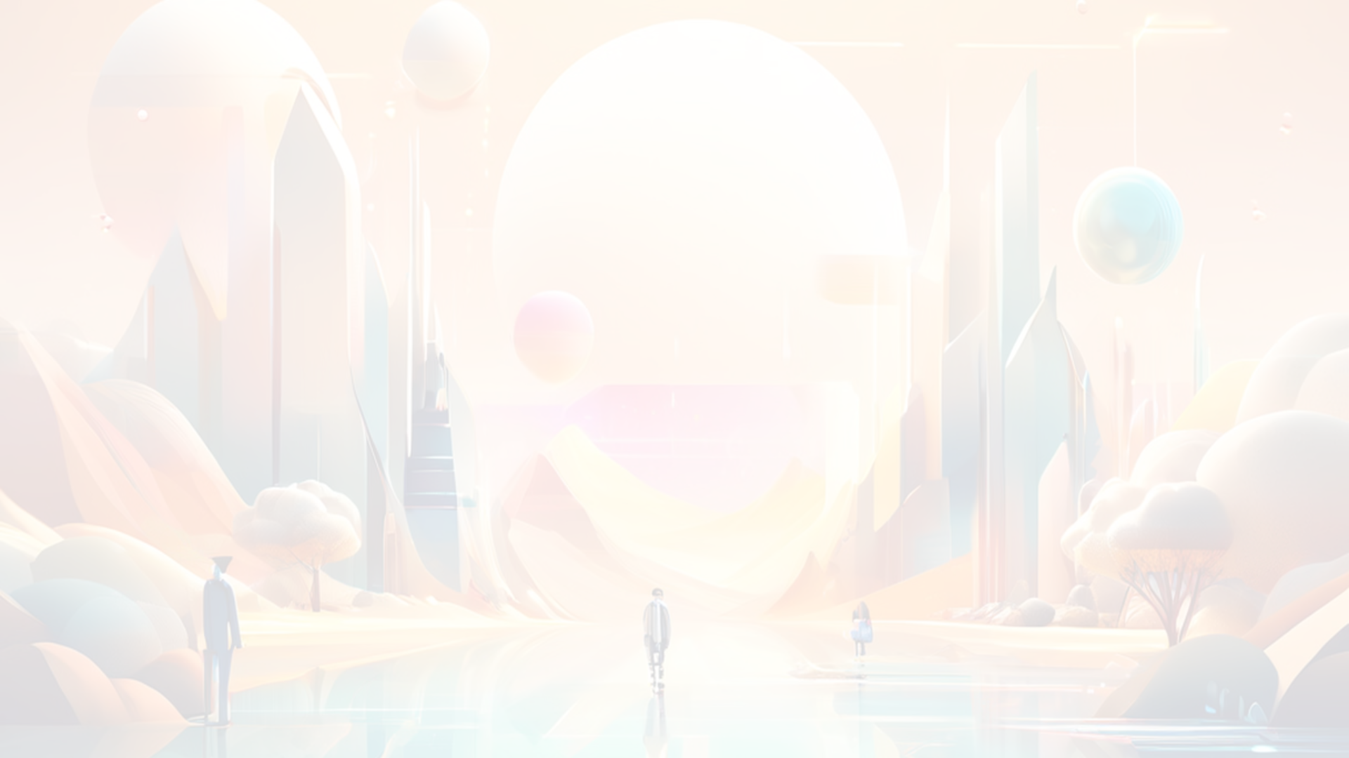

Opportunities and Potential of NFTs
Unlocking Creativity
New Revenue Streams
NFTs empower digital artists and creators to explore new forms of expression and monetization.
NFTs allow creators to generate ongoing royalties from the resale of their digital works.
1
2
3
Digital Collectibles
NFTs can transform digital assets into scarce, tradable collectibles, creating new markets.

Slide 11
Challenges and Limitations of Blockchain and NFTs
Environmental Impact
Regulatory Uncertainty
The energy-intensive nature of some blockchain technologies has raised concerns about their environmental footprint.
The legal and regulatory landscape surrounding blockchain and NFTs continues to evolve, creating uncertainty for users.
Scalability Issues
Market Volatility
Some blockchain networks face challenges in handling large transaction volumes and maintaining fast processing times.
The value of NFTs can be highly volatile, subject to market trends and speculative activity.

Slide 12
The Future of Blockchain and NFTs
Mainstream Adoption
As awareness and understanding of blockchain and NFTs grow, their integration into mainstream applications and industries is expected to accelerate.
Interoperability
Efforts to establish common standards and protocols will enable seamless integration and exchange of NFTs across different platforms and ecosystems.
Sustainable Solutions
Advancements in blockchain technology, such as the transition to proof-of-stake consensus mechanisms, will help address environmental concerns.
Expanded Utilities
The application of blockchain and NFTs will continue to expand, potentially revolutionizing sectors like finance, healthcare, and social media.

